Slide 1
TWIDDLER
Rui Li, Yufan Xue
Software Engineering
April 4, 2014

Slide 2
OVERVIEW
Manage assessment activities for academic programs
Student learning outcomes(organized around hierarchically categorized)
Support multiple Universities
Support other types of academically oriented clients

Slide 3
STUDENT LEARNING OUTCOME
short statement that describes a specific objective for some academic unit
SLO's are associated with courses, programs, degrees and perhaps others. These mappings form possibly complex graphs.
Examples
Students will be able to write a quicksort algorithm in Java.
Students will be able to explain the political theories: Communism, Democracy, and Populism.
Students will be able to use an Autel diagnostics tool to identify engine errors for any supported vehicle type.

Slide 4
SLO HEIRARCHY
A University might define a program as a collection of courses and each course might be defined as a collection of SLOs
Graduates of the program are then characterized by the union of all course SLOs in the program

Slide 5
ASSESSMENT
Use SLOs to assess how well the program trains students
Many Types
Quiz
Exam
Homework assignment
Others
Support the collection and recording of assessment data for each SLO in the system

Slide 6
COMPUTATIONAL DETAILS
Roles
Application administrator
Operates on behalf of the company that sells Twiddler.
Account administrator
Operates on behalf of a Twiddler customer. Typically a University
Licensed user
The licensed user is anyone an account administrator awards a license to

Slide 7
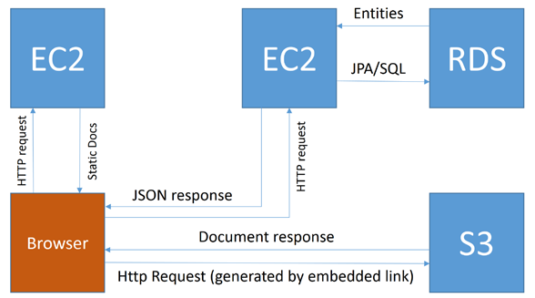
Architectural Elements
ARCHITECTURE
Deployed on Amazon web services
EC2 machine for deploying static HTML, JavaScript, CSS and any other supporting documents
Separate EC2 machine to supply all JSON data to the browser
RDS will be used to store user data, access control lists, assessment document meta-data, SLOs and SLO groups
S3 will be used to store assessment documentation

Slide 8
TECHNOLOGIES
The application is JEE compliant using JPA as the persistence layer.
The application will be developed using Spring security and control
AngularJS will manage the client-side application
Bootstrap will be used as the layout and styling engine
Tiles will be used to manage components/templates
HTML documents are written in HTML5

Slide 9
Challenge
Permission control
Relations between SLOs and courses, department, etc.
Technologies like amazon web service

Slide 10
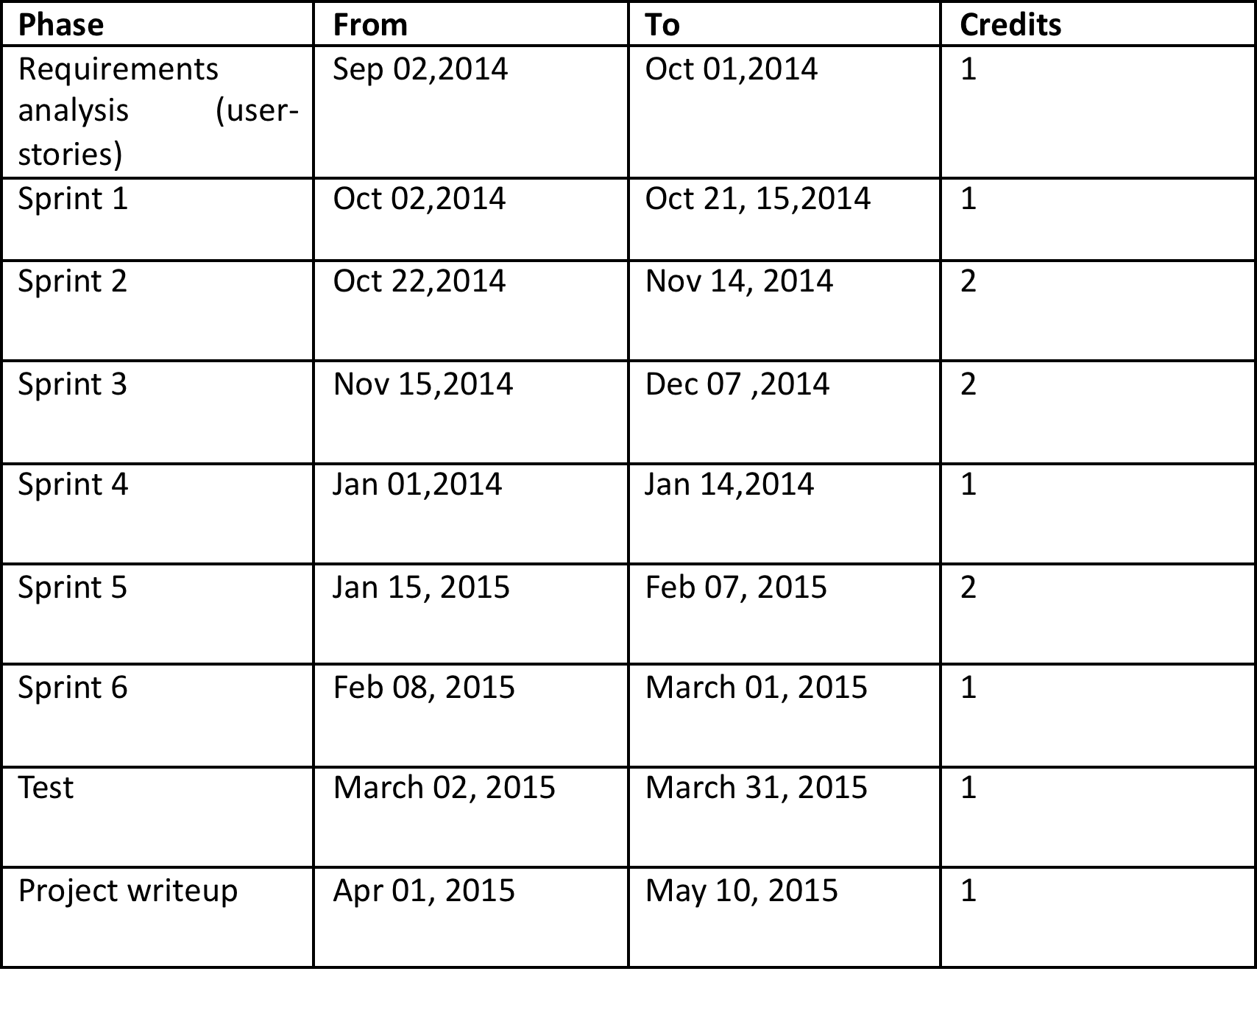
Schedule

